Slide 1

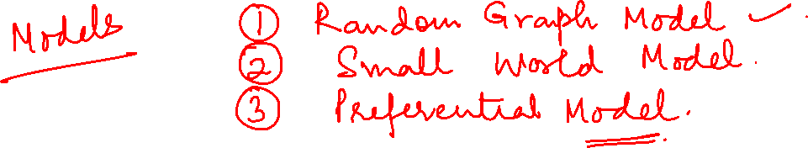
Graph Theory and Its Applications
Random Graph Models
Dr. Arti Arya
Department of Computer Science
and Engineering

Slide 2

Graph Theory and Its Applications
Erdos Renyi random graph model
Dr. Arti Arya
Department of Computer Science and Engineering

Slide 3
Disclaimer
The course slides are prepared by Prof. BhaskarJyoti. But various additional inputs are added by me from various reliable resources from Foreign and Indian Universities as well as from sites.
Notes:
Ok. Having said that, lets get back to what we were speaking about.
Input devices. We have seen that the virtual reality eco system largely encompasses three fundamental components that include
HMD – head mounted devices that give you immersive VR experience, we saw some examples in the last class like the HTC VIVE, Oculus Rift, Samsung gear and so on. Some of you have also used few of these and experienced it for a few minutes.
And the second components is the GTD or the Gesture Tracking Devices. We saw a video of Xsense IMU sensors that can accurately estimation the position and orientation of a dancer. we will in the next hour see how these gesture tracking devices work and what are the various technicalities that go into tracking. I will try to keep it as non-mathematical as possible, as the mathematics behind it can get pretty messy and complicated. However, if you are interested in the mathematical aspects, I will be more than happy to discuss.
On the screen you can see that a 3 directional coordinate system is depicted. The 3 primary axes of a 3d coordinate system is X, Y and Z axis. Hear I would like to know where, when and why in your past have you encountered 3 dimensional coordinate system.
Give some time to the students to ponder on
Ok, if I tell you, I have encountered 2 dimension in images, drawings, sketch and so on. While I have encountered 1 dimension when I want to know the temperature currently or current time or something like that. Similar, where and when have you encountered 3D, either consciously or subconsciously.
Explain the roll pitch and yaw concepts.
Degree of freedom

Slide 4
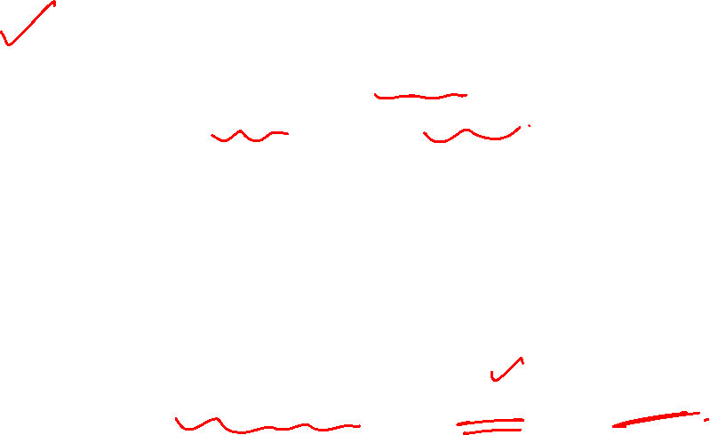
Basic assumption
We start with the most basic assumption on how friendships are formed.
Friendships in real-world are not random.
Still we consider the random friendships represented by RG models( thinking to simplify the process of friendship formation in real-world n/ws) and hope that these friendships will start exhibiting common characteristics of real-world n/w over time.
We will discuss two random graph models : G(n,p) and G(n,m)
Random Graph’s main assumption:
Edges (i.e., friendships) between nodes (i.e., individuals) are formed randomly.

Slide 5
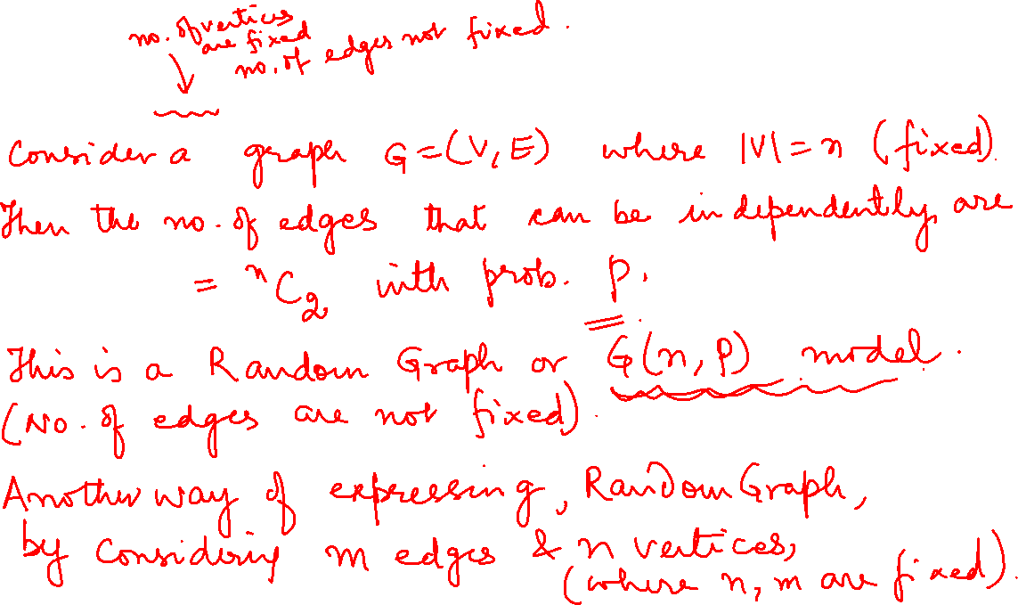
Erdos Renyi G(n,p) model

Slide 6
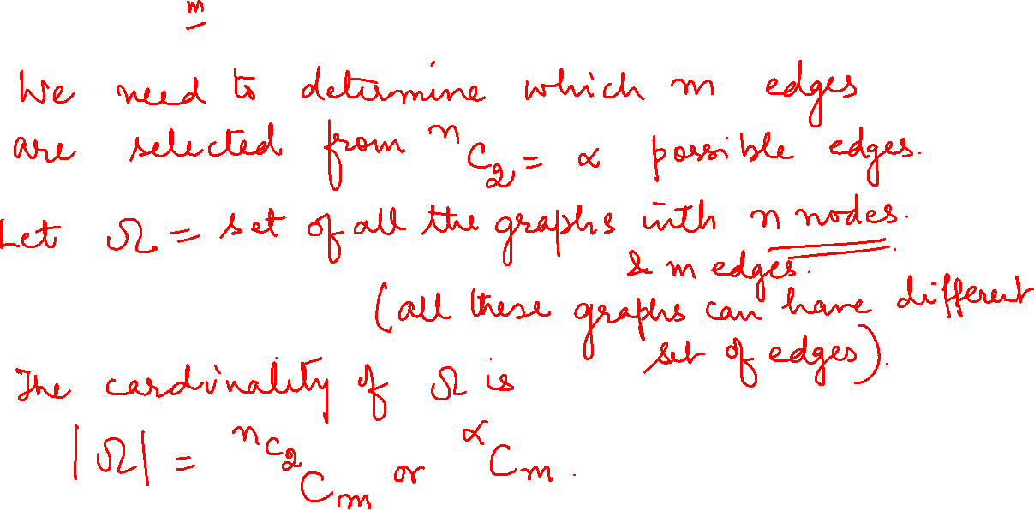
Erdos Renyi G(n,p) model

Slide 7
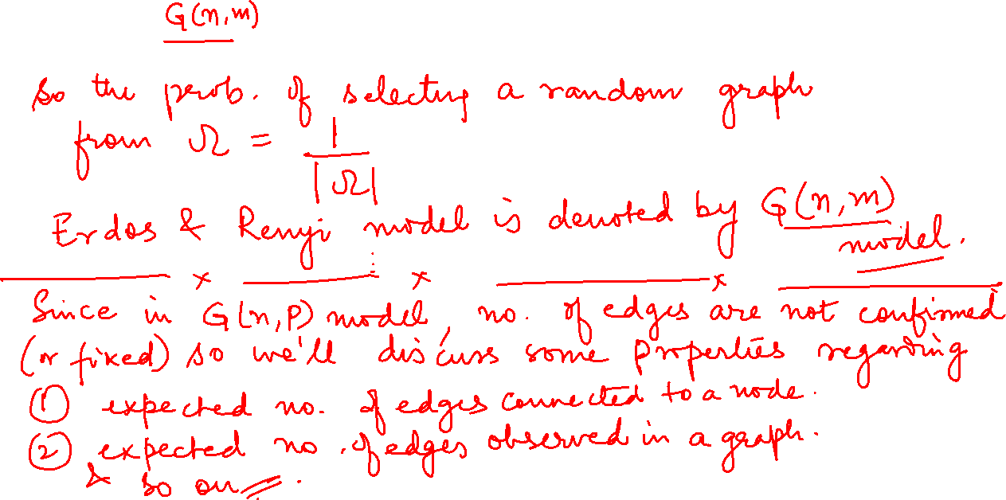
Erdos Renyi G(n,p) model

Slide 8
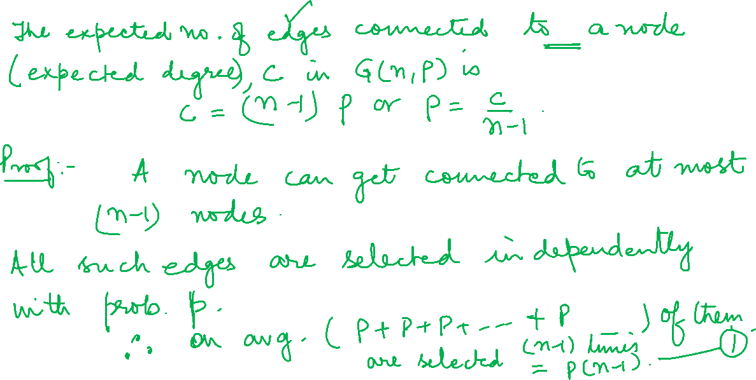
Property 1

Slide 9

Modeling real world network with random graph
We have a real network where we know the number of nodes (n) and degree distribution.
We can compute the average degree c from the distribution
We can then compute p, by using “expected degree of a node” formula p= c/(n-1)
We can then generate the random graph. Using p and the number of nodes in the given network n, a random graph model G(n, p) can be simulated.

Slide 10
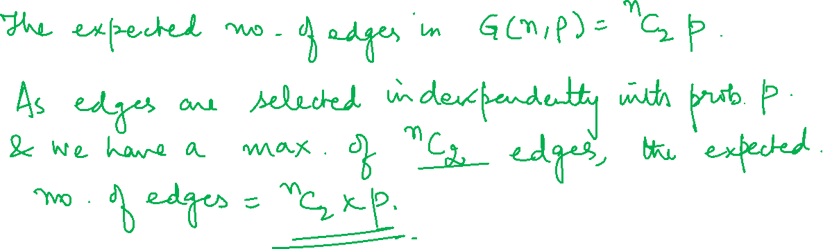
Property 2

Slide 11
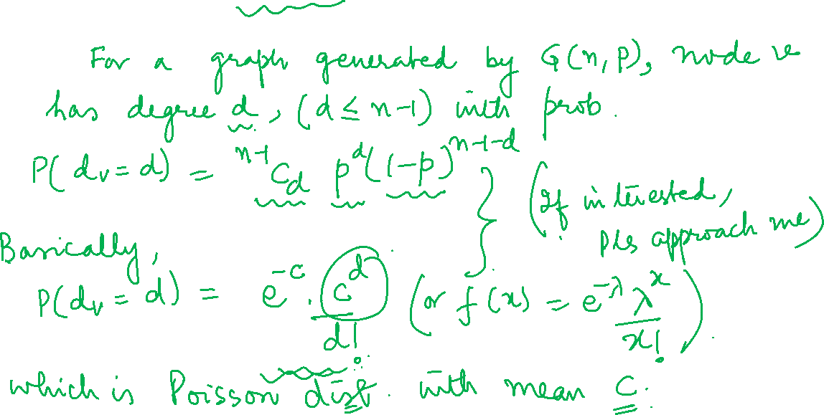
Properties of Random Graph Models : Degree Distribution
Prop 1

Slide 12
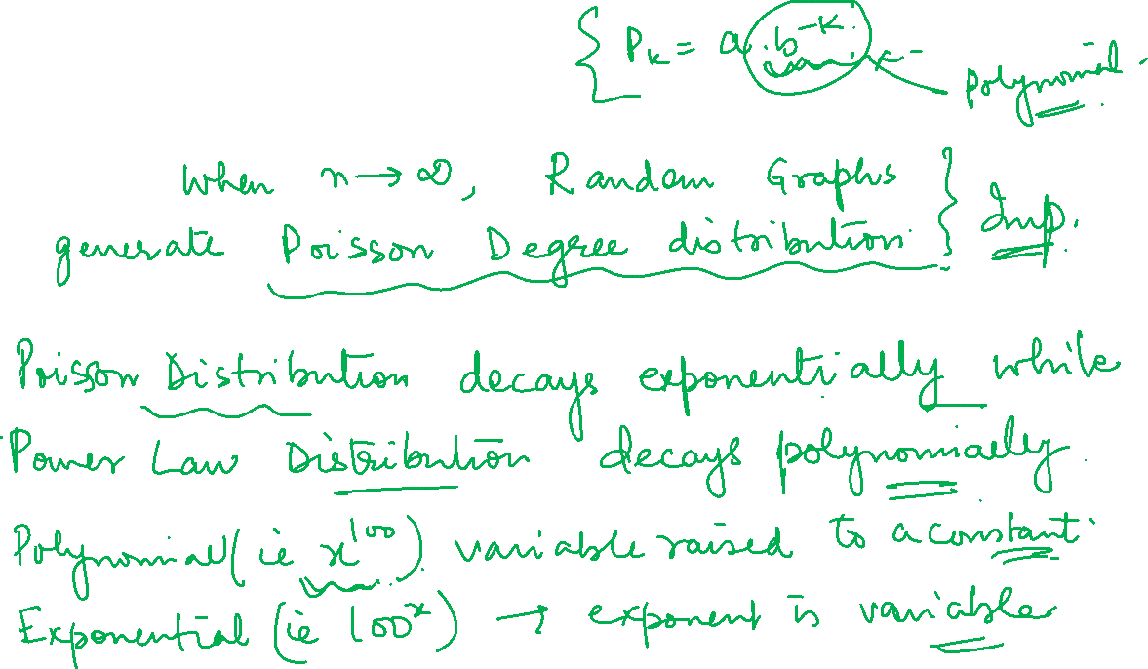
Properties of Random Graph Models : Degree Distribution
Prop 1

Slide 13
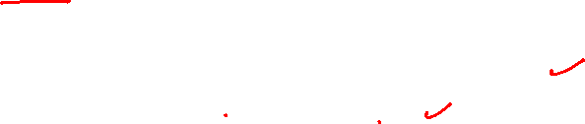
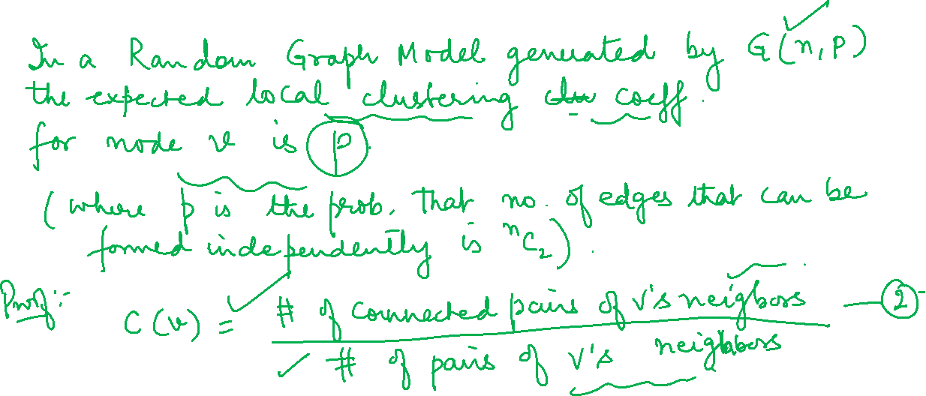
Properties : Clustering Coeff of Random Graph Models
Prop 2

Slide 14
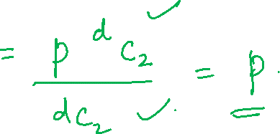
Properties : Clustering Coeff of Random Graph Models
Prop 2
Slide 39

Slide 15
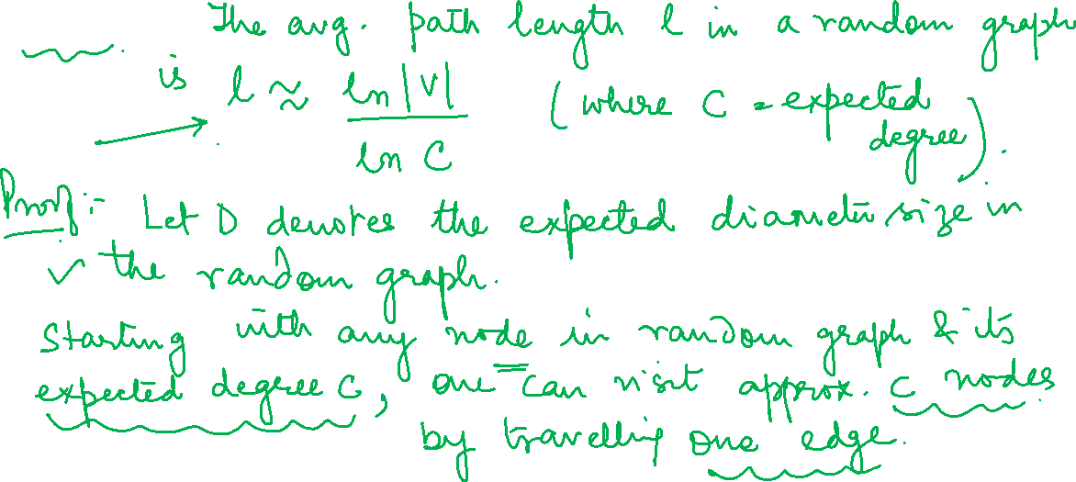
Properties : Avg Path length in Random Graph Model
Prop 1

Slide 16
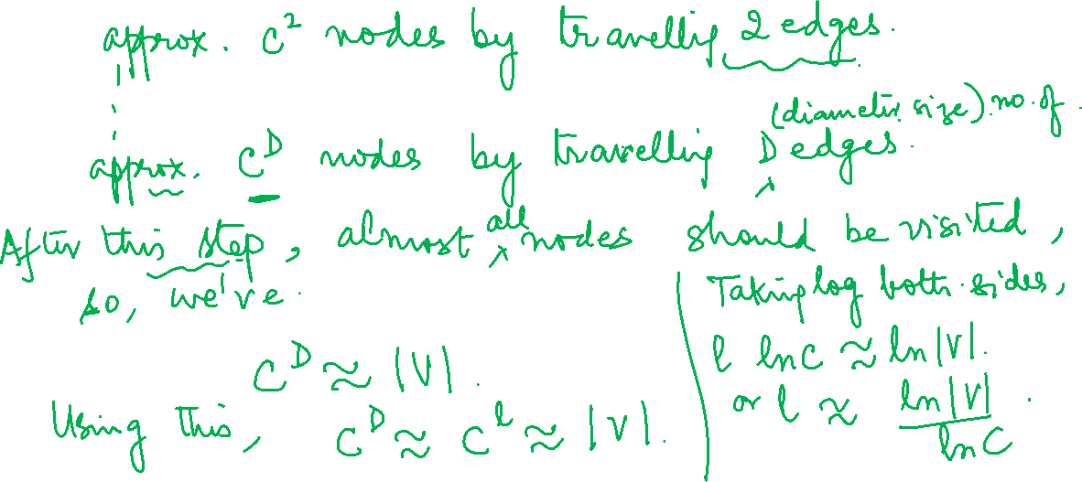
Properties : Avg Path length in Random Graph Model
Prop 1

Slide 17
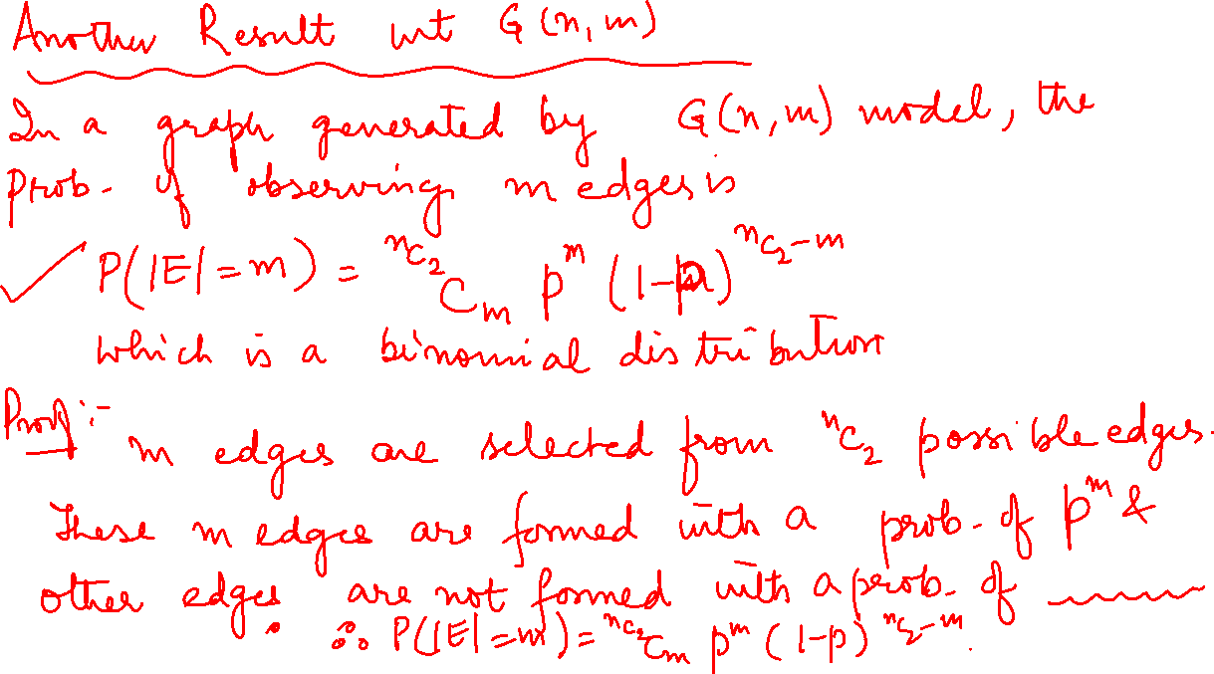

Slide 18
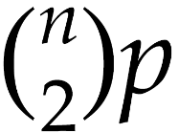
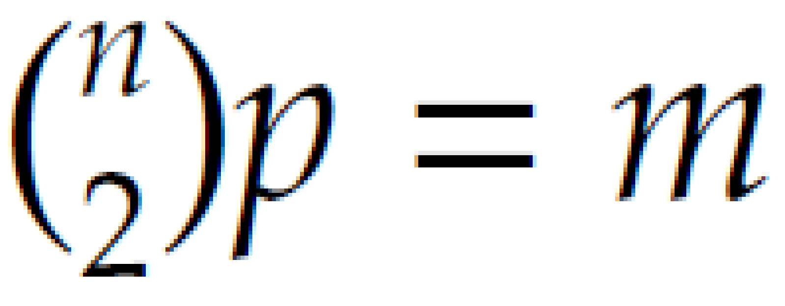

G(n,p) vs. G(n,m)
When n is large), both models G(n, p) and G(n, m)) act similarly
The expected number of edges in G(n, p) is
We can set and in the limit, we should get similar results.
Differences:
The G(n, m) model contains a fixed number of edges
The G(n, p) model is likely to contain none or all possible edges

Slide 19
Modeling real world network with random graph
We have a real network where we know the number of nodes (n) and degree distribution.
We can compute the average degree c from the distribution
We can then compute p, by using “expected degree of a node” formula p= c/(n-1)
We can then generate the random graph. Using p and the number of nodes in the given network n, a random graph model G(n, p) can be simulated.

Slide 20
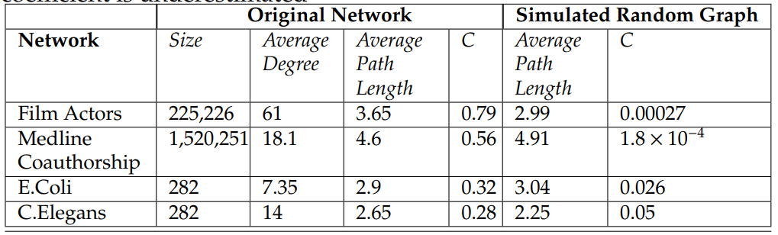
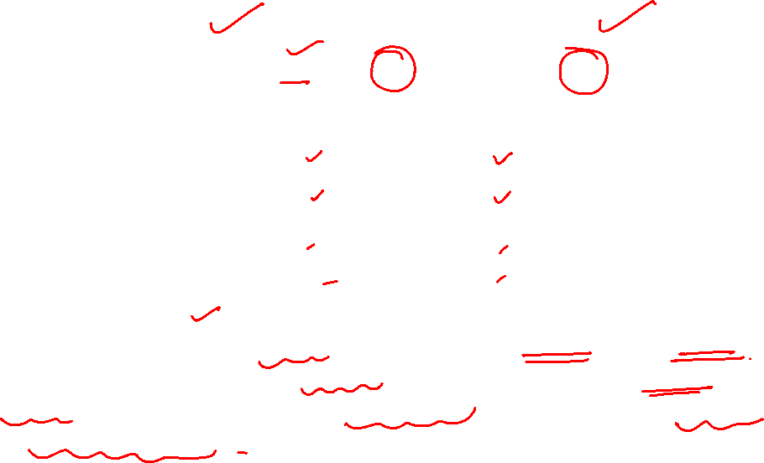
Modeling real world network with random graph
Random graphs perform well in modeling the average path lengths; however, when considering the transitivity, the random graph model drastically underestimates the clustering coefficient. To tackle this issue, we study the Small-World model.

Slide 21

NETWORK ANALYSIS AND MINING
Erdos Renyi G(n,p) model
Formally, we can assume that for a graph with a fixed number of nodes n, any of the edges can be formed independently, with probability p.
This graph is called a random graph and we denote it as G(n, p) model
C(n, 2) or is # of combinations of two objects from a set of n objects
No of edges m are not fixed !

Slide 22
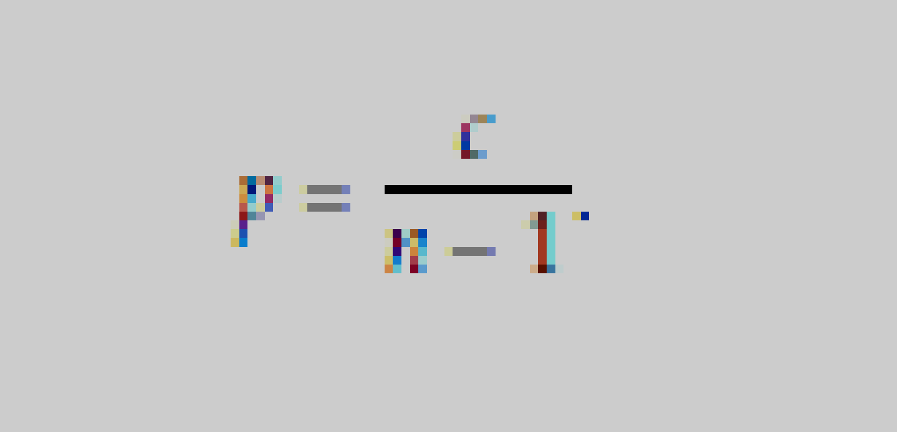
NETWORK ANALYSIS AND MINING
Expected degree or number of edges of a node
The expected number of edges connected to a node (expected degree) c in G(n, p) graph is c=(n - 1)p
A node can be connected to at most n-1 nodes (or n-1 edges)
All edges are selected independently with probability p
Therefore, on average, (n - 1)p edges are selected
c=(n-1)p or equivalently,

Slide 23
NETWORK ANALYSIS AND MINING
Modeling real world network with random graph
We have a real network where we know the number of nodes (n) and degree distribution.
We can compute the average degree c from the distribution
We can then compute p, by using “expected degree of a node” formula p= c/(n-1)
We can then generate the random graph. Using p and the number of nodes in the given network n, a random graph model G(n, p) can be simulated.

Slide 24
NETWORK ANALYSIS AND MINING
Modeling real world network with random graph
Random graphs perform well in modeling the average path lengths; however, when considering the transitivity, the random graph model drastically underestimates the clustering coefficient. To tackle this issue, we study the small-world model.

Slide 25
NETWORK ANALYSIS AND MINING
Expected number of edges in a G(n,p) graph
The expected number of edges in G(n, p) is p
Proof:
Since edges are selected independently, and we have a maximum edges, the expected number of edges is p

Slide 26
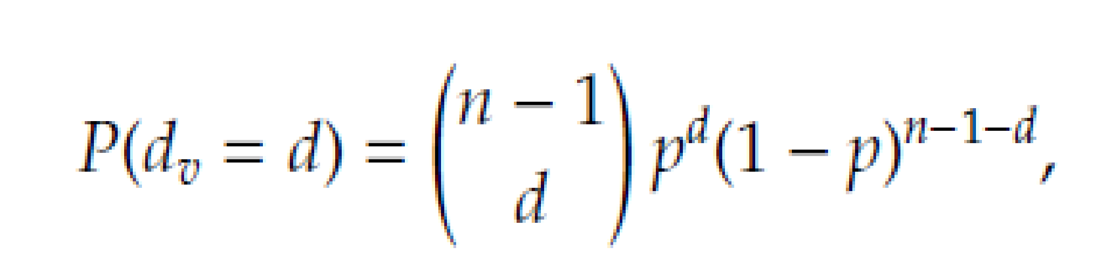
NETWORK ANALYSIS AND MINING
Probability of observing degree d
When computing degree distribution, we estimate the probability of observing degree d of node v (d_{v} ) i.e. P(d_{v} = d)
For a random graph generated by G(n,p) this probability is (binomial)
Each node has (n-1) nodes to form edges and the probability is p for each

Slide 27


NETWORK ANALYSIS AND MINING
Degree distribution in a random graph
In a Erdos-Renyi (uniform) Random Graph with n nodes
As n🡪infinity, this becomes a Poisson distribution (where λ is the mean degree and is equal to pn, for large n and small p )
Note that Poisson decays exponentially while power law decays polynomially ( there is a difference)
Polynomial ( i.e. x ⁵) – variable raised to some constant power ; Exponential (i.e. 5^{x})– variable is the exponent
Notes:
Exponential decay ..DN/dt = -lambda*N when lambda is decay constant
So. N(t) = N₀ * exp (-lamba*t)
Power law P_{k} = a k^{-b}

Slide 28

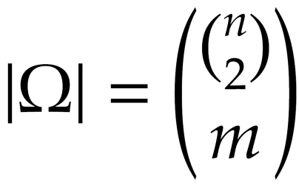
NETWORK ANALYSIS AND MINING
Erdos Renyi random graph G(n,m) model
Another way is to assume both number of nodes n and number of edges m are fixed.
However, we need to determine which m edges are selected from the set of possible edges
Let denote the set of graphs with n nodes and m edges
There are |Ω| different graphs with n nodes and m edges
To generate a random graph, we uniformly select one of the |Ω| graphs (the selection probability is 1/|Ω|)
This model proposed first by Paul Erdos and Alfred Renyi

Slide 29
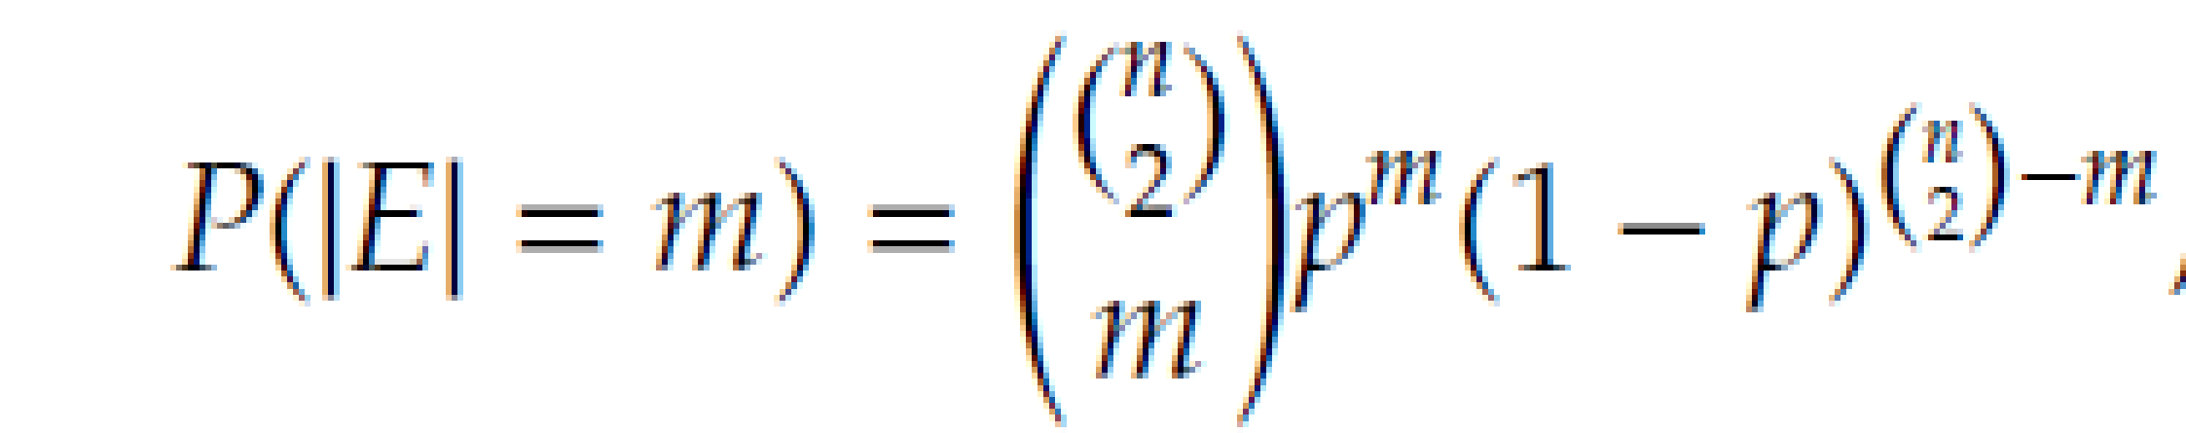
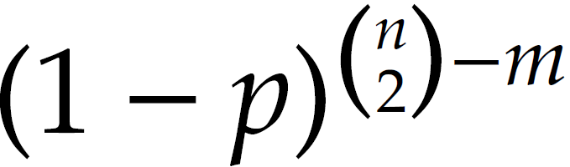
NETWORK ANALYSIS AND MINING
Probability of observing m edges in G(n,m) graph
Given the G(n, m) process, the probability of observing m edges is binomial distribution
Proof:
m edges are selected from the possible edges.
These m edges are formed with probability p^{m} and other edges are not formed (to guarantee the existence of only m edges) with probability

Slide 30
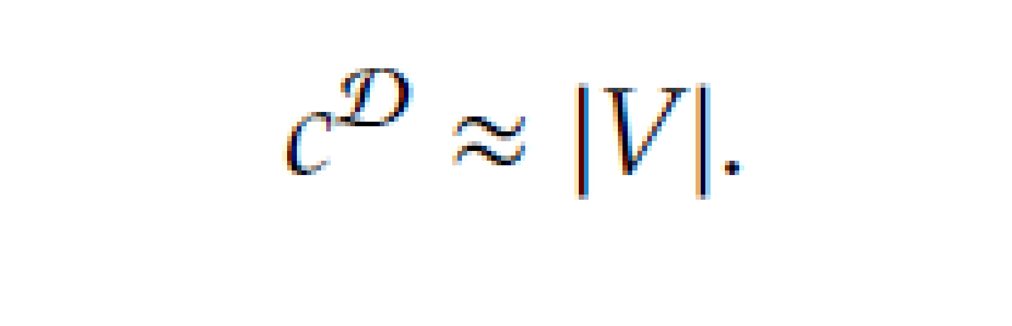

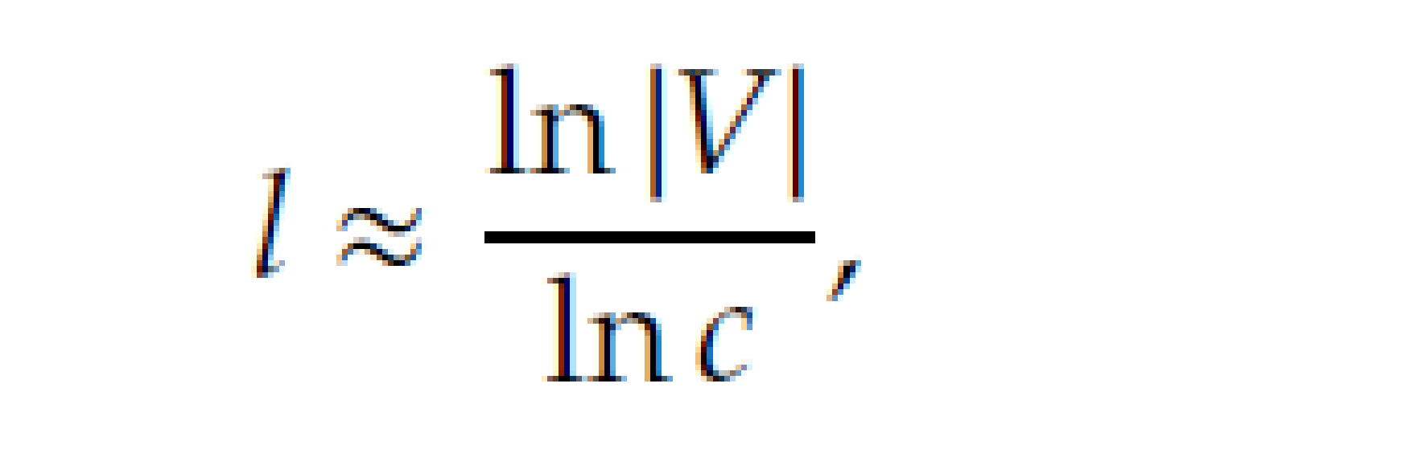
NETWORK ANALYSIS AND MINING
Average Path Length in Random Graph Model
Let D denote the expected diameter size in the random graph.
Starting with any node in a random graph and its expected degree c, one can visit approximately c nodes by traveling one edge, c² nodes by traveling two edges, and c^{D} nodes by traveling “diameter” number of edges.
After this step, almost all nodes should be visited. In this case, we have the first expression above
In Random Graph, the expected diameter size tends to average shortest path length in the limit (proof excluded) . So, we haver the 2nd expression
Taking logarithm of both sides, we have final expression

Slide 31
NETWORK ANALYSIS AND MINING
G(n,p) vs. G(n,m)
In the limit (when n is large), both models (G(n, p) and G(n, m)) act similarly
The expected number of edges in G(n, p) is
We can set and in the limit, we should get similar results.
Differences:
The G(n, m) model contains a fixed number of edges
The G(n, p) model is likely to contain none or all possible edges

Slide 32
NETWORK ANALYSIS AND MINING
What is skipped
Mathematical proof
Expression for average path length
A rigorous proof that shows that the degree distribution becomes a Poission distribution for very large n

Slide 33
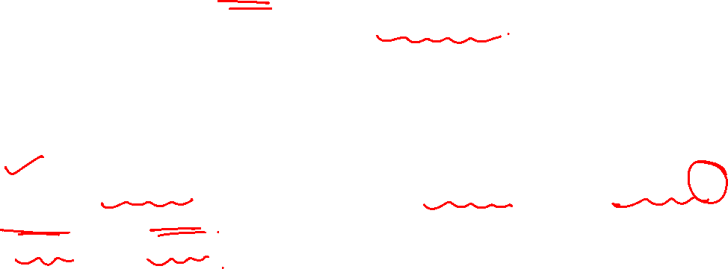
Evolution of Random Graphs
When nodes form connections, after some time a large fraction of nodes get connected.
This large fraction forms a connected component, commonly called the largest connected component or the giant component.
(play http://networksciencebook.com/chapter/3#evolution-network)
One can tune the behavior of the random graph model by selecting the appropriate p value. ( # of edges that can be formed independently with a prob. ‘p’)
In G(n, p), when p = 0, the size of the largest connected component is 0 (no two pairs are connected), and
when p = 1, the size is n ( all pairs connected)

Slide 34
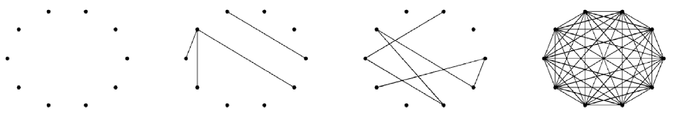
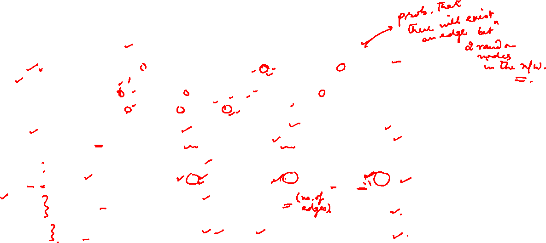
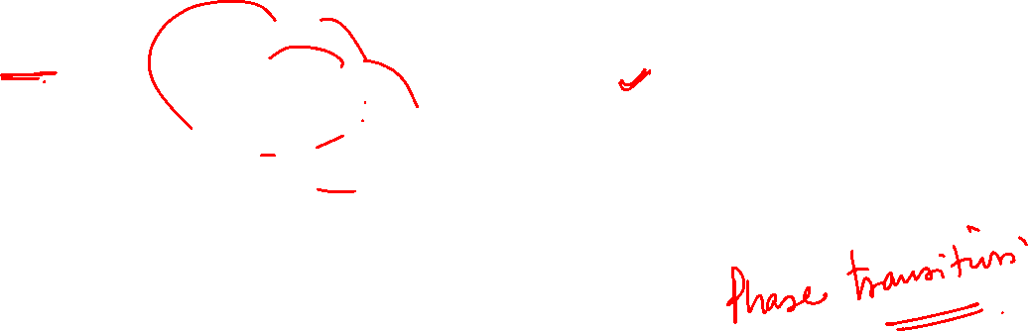
Evolution of Random Graphs
Giant component formation : an example with increasing p for 10 nodes
Probability (p) | 0.0 | 0.055 | 0.11 | 1.0
Average node degree (c) | 0.0 | 0.8 | ~1 | n-1 = 9
Diameter (ds) | 0 | 2 | 6 | 1
Giant component size (slc) | 0 | 4 | 7 | 10
Average path length (l) | 0.0 | 1.5 | 2.66 | 1.0
The table provides information on the average degree c, the diameter size ds, the size of the largest component slc, and the average path length l of the random graph.

Slide 35
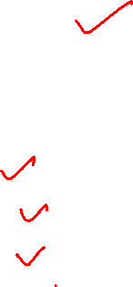
With small p
At p = 0, there are no components
As probability p is small ( p = 0.055)
No giant component is observed in the graph.
Small isolated components are formed.
The diameter is small because all nodes are in isolated components, in which they are connected to a handful of other nodes.

Slide 36
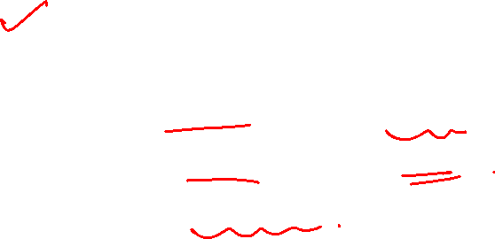
With large p =0.11
Large p
A giant component starts to appear.
Isolated components become connected.
The diameter values increase ( nodes are connected to each other via long paths)

Slide 37
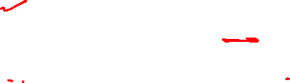
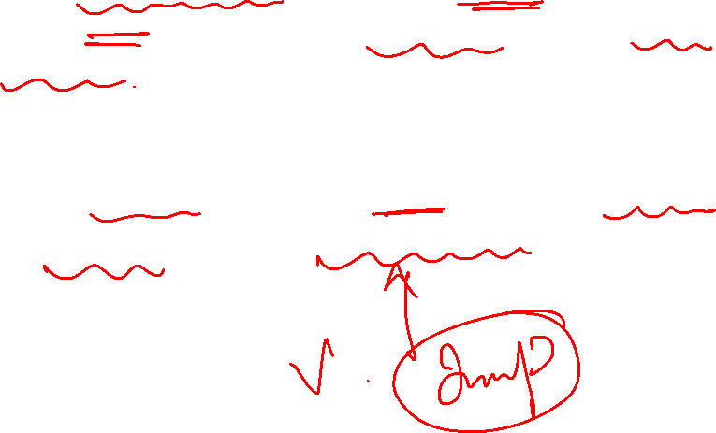
With very large p near 1.0
For very large value of p, the diameter shrinks as nodes can get connected by shorter paths ( more paths being available).
The point where diameter value starts to shrink in a random graph is called phase transition.

Slide 38
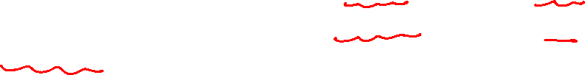
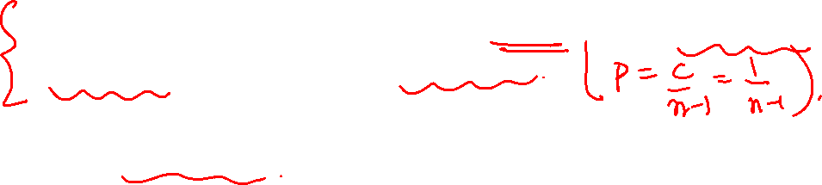
Phase transition ( proof not included)
In a random graph, phase transition happens when average node degree, c = 1, or when p = 1/(n-1)
At the point of Phase Transition,
The giant component that just started to appear, starts to grow, and then the diameter that just reached its maximum value, starts decreasing.

Slide 39
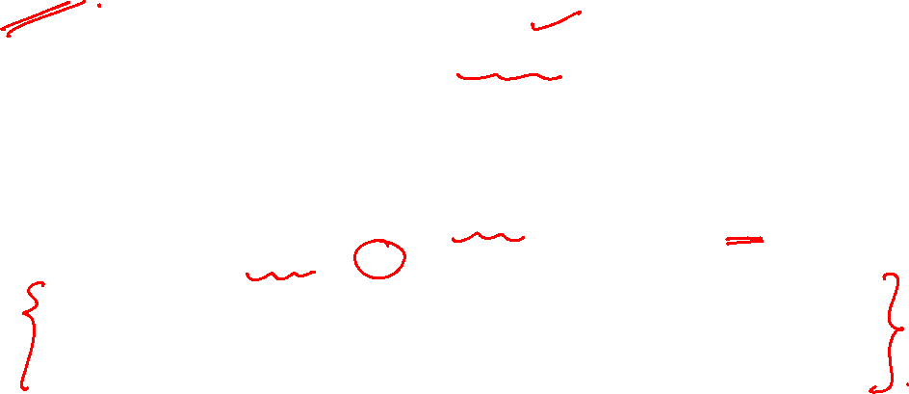
Local clustering coefficient of random graph
( Already seen in one of the previous slides)
The expected local clustering coefficient for node v of a random graph generated by G(n, p) is p
That is intuitive if we consider the expected no of connections
The numerator of CC = p * ^{n-1}C₂
The denominator is ^{n-1}C₂

Slide 40
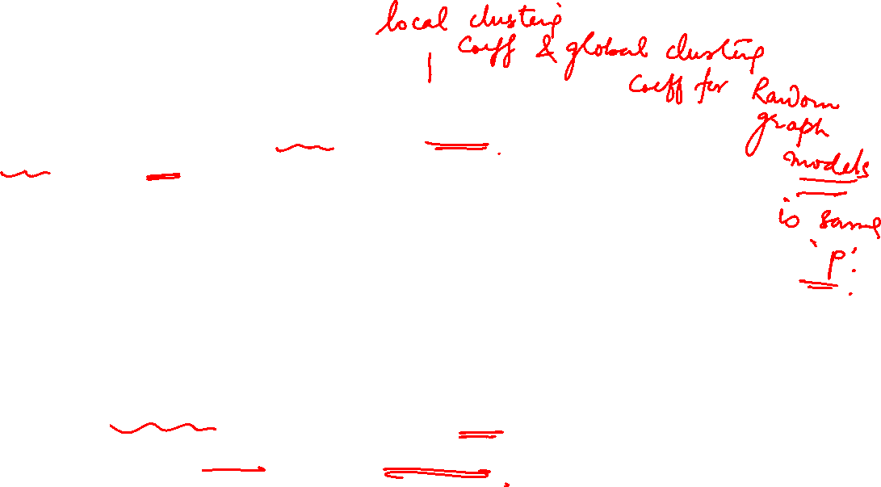
NETWORK ANALYSIS AND MINING
Global clustering coefficient of a random graoh
The global clustering coefficient of a random graph generated by G(n, p) is also p
The global clustering coefficient of a graph defines the average probability of two neighbors of the same node being connected.
In random graphs, for any two nodes, this probability is the same and is equal to the generation probability p that determines the probability of two nodes getting connected.
Note that in random graphs, the expected local clustering coefficient is equivalent to the global clustering coefficient.

Slide 41
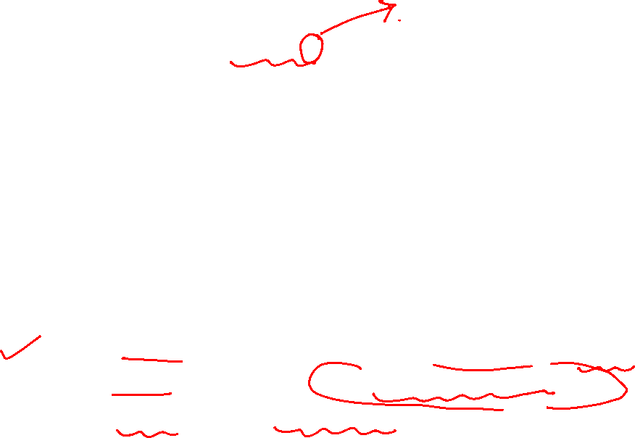
NETWORK ANALYSIS AND MINING
Shortcomings of high value of p in random graph model
In random graphs, the local and global clustering coefficient is equal to the probability p
By appropriately selecting p, we can generate networks with a high clustering coefficient.
Note that selecting a large p is undesirable because doing so will generate a very dense graph, which is unrealistic, as in the real-world, networks are often sparse.
Thus, random graphs are considered generally incapable of generating networks with high clustering coefficients without compromising other required properties.

Slide 42
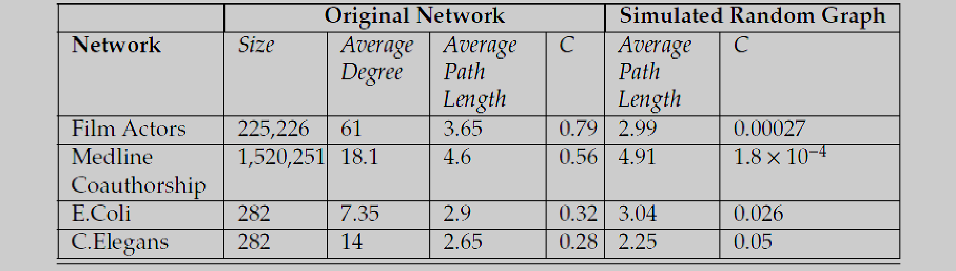
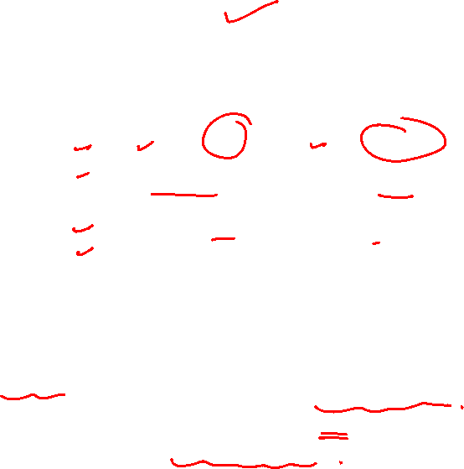
NETWORK ANALYSIS AND MINING
How good is the random graph model ?
* C is the average clustering coefficient
How good is the model?
Random graphs perform well in modeling the average path lengths;
However, when considering the transitivity, the random graph model drastically underestimates the clustering coefficient.

Slide 43
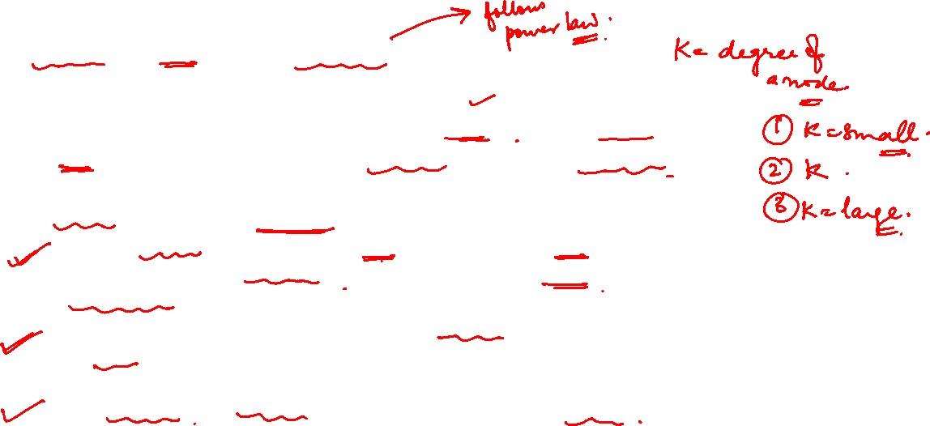
NETWORK ANALYSIS AND MINING
Random graph model vs scale free network
The main difference between a random and a scale-free network comes in the tail of the degree distribution, representing the high-k region of p_{k}. If we compare a power law with a Poisson function. We find that:
For small k the power law is above the Poisson function, indicating that a scale-free network has a large number of small degree nodes, most of which are absent in a random network.
For k, in the vicinity of 〈k〉 the Poisson distribution is above the power law, indicating that in a random network there is an excess of nodes with degree k≈〈k〉.
For large k the power law is again above the Poisson curve. The difference is particularly visible if we show p_{k}on a log-log plot indicating that the probability of observing a high-degree node, or hub, is several orders of magnitude higher in a scale-free than in a random network.

Slide 44
NETWORK ANALYSIS AND MINING
Scale free ?
A Scale Free Network is one in which the distribution of links to nodes follows a power law.
Or A scale-free network is one with a power-law degree distribution
Networks with power-law distributions are called scale-free because power laws have the same functional form at all scales i.e. remains unchanged other than a multiplicative factor when rescaling the independent variable k
p_{k} = a(ck)^{-b} = a.c^{-b} .k^{-b} = a’ .k^{-b}
(where p_{k} denote the fraction of individuals having degree k.)

Slide 45
NETWORK ANALYSIS AND MINING
Scale free networks examples
Several networks are claimed to be scale-free
World wide web
Social networks, including collaboration networks. Two examples that have been studied extensively are the collaboration of movie actors in films and the co-authorship by mathematicians of papers.
Some financial networks such as interbank payment networks
Protein-protein interaction networks.
Semantic networks
Airline networks.

Slide 46
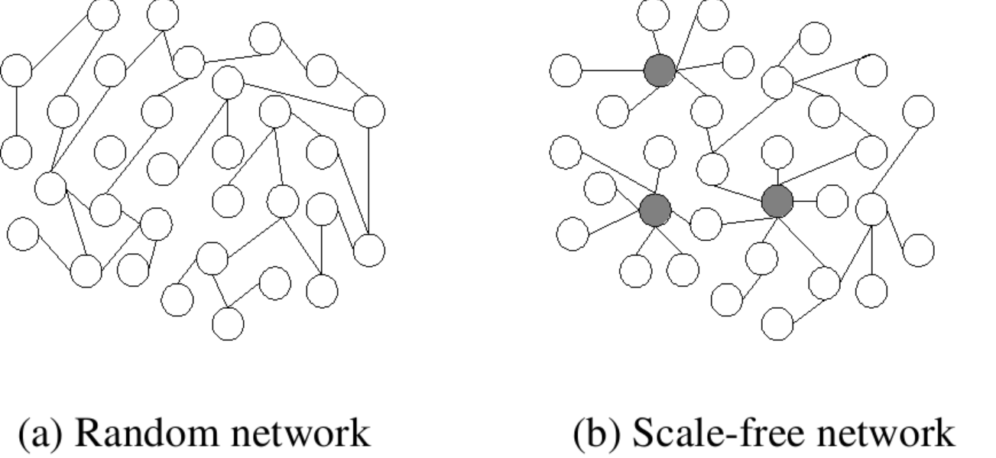
NETWORK ANALYSIS AND MINING
Scale free networks are also fat tailed network
Additionally, scale-free networks are a type of network where large hubs are present. (A hub is a node with a number of links that greatly exceeds the average.)
Also known as heavy tails, fat tails describe the greater-than-expected probabilities of extreme values.
If in a Gaussian distribution there is, say, a 1% chance of a quantity taking values greater than some extreme value, this probability will be higher in a fat-tailed distribution.

Slide 47
NETWORK ANALYSIS AND MINING
Scale free networks are also fat tailed network
We call a network fat tailed if its degree distribution follows power law and a tail in the high-k region. ( certain nodes with high value than k).
Outliers, or exceptionally high-degree nodes, are not only allowed but are expected in these networks

Slide 48
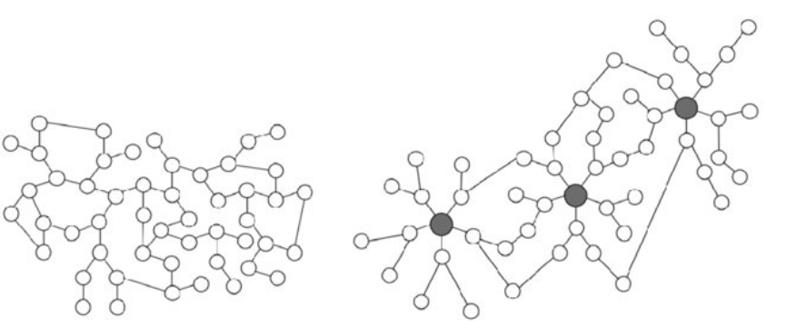
NETWORK ANALYSIS AND MINING
Scale free networks
Random Network Scale Free Network
Scale-free network follows power-law and is inhomogeneous. Most nodes have one or two links but a few highly-connected nodes, so-called hubs,(have a large number of links). Eg The airline network, follow scale-free network. White circles indicate nodes and dark ones indicate hubs that are highly connected nodes.
Random network follows Poisson distribution and is nearly homogenous. Most nodes have approximately the same numbers of links. The road system, for example, fits with this type of network model.

Slide 49
NETWORK ANALYSIS AND MINING
Scale free network properties
A scale-free network is a network whose degree distribution follows a power law, at least asymptotically.
The fraction p(k) of nodes in the network having k connections to other nodes is p(k) = a. k ^{-b} where b is a parameter in the range of 2 and 3 typically & a > 0 typically
Another important characteristic of scale-free networks is the clustering coefficient distribution, which decreases as the node degree increases. This distribution also follows a power law.
This implies that the low-degree nodes belong to very dense sub-graphs
Interpretation : those sub-graphs are connected to each other through hubs as most scale free networks are heavy or fat tailed.

Slide 50
NETWORK ANALYSIS AND MINING
Scale free networks – other properties
Scale-free networks also exhibit small-world phenomena
For a random graph having the same power law distribution as the Web graph, it has been shown that i.e. Avg path length = 0.35 + log₁₀ N
Scale-free networks tend to be more brittle
You can drastically reduce the connectivity by deliberately removing a few nodes, specially the hubs
This can also be seen as an opportunity..
Disease prevention by quarantining super-spreaders
Bar´abasi-Albert (BA) model was the first model for scale free networks (coming later …)

Slide 51
NETWORK ANALYSIS AND MINING
Random graph model vs scale free network
The main difference between a random(which follows Poisson dist) and a scale-free network(follows power law) comes in the tail of the degree distribution, representing the high-k region of p_{k}. If we compare a power law with a Poisson function. We find that:
For small k the power law is above the Poisson function, indicating that a scale-free network has a large number of small degree nodes, most of which are absent in a random network.
For k, in the vicinity of avg degree=〈k〉 the Poisson distribution is above the power law, indicating that in a random network there is an excess of nodes with degree k≈〈k〉.
For large k the power law is again above the Poisson curve. The difference is particularly visible if we show p_{k}on a log-log plot indicating that the probability of observing a high-degree node, or hub, is several orders of magnitude higher in a scale-free than in a random network.
Lets discuss it now

Slide 52
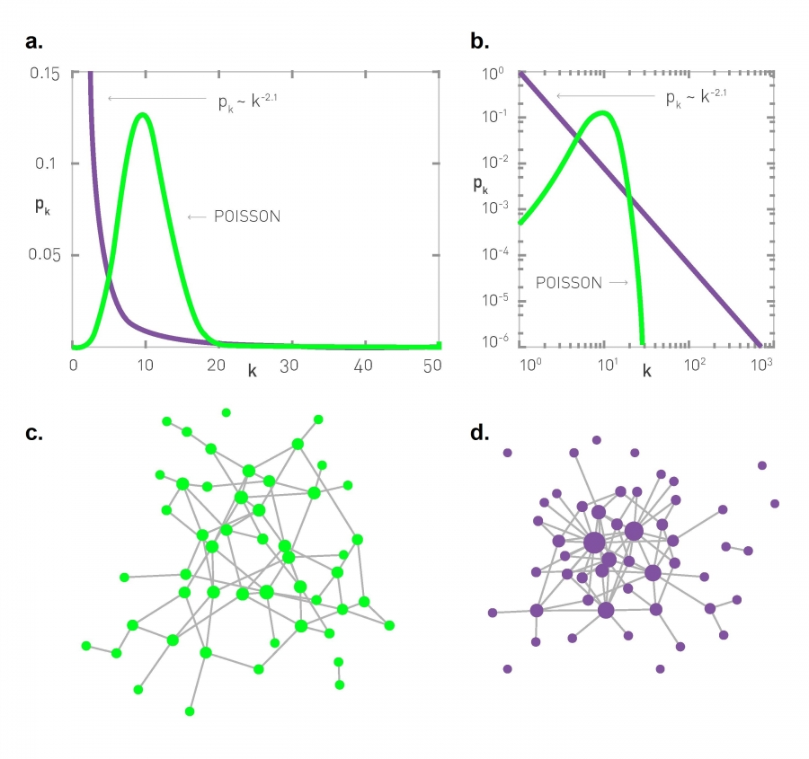
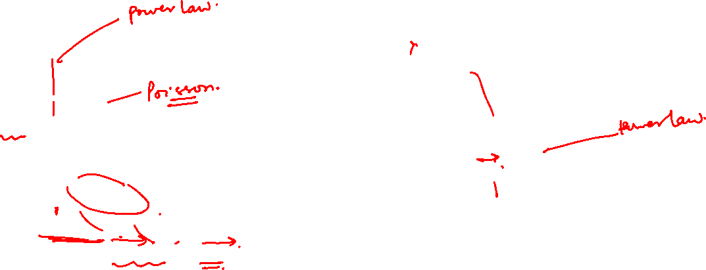
NETWORK ANALYSIS AND MINING
Random graph (Poisson) vs. scale free
Fraction of degree vs degree
Log log plot
The most notable characteristic in a scale-free network is the relative commonness of vertices with a degree that greatly exceeds the average. The highest-degree nodes are often called "hubs“.

Slide 53
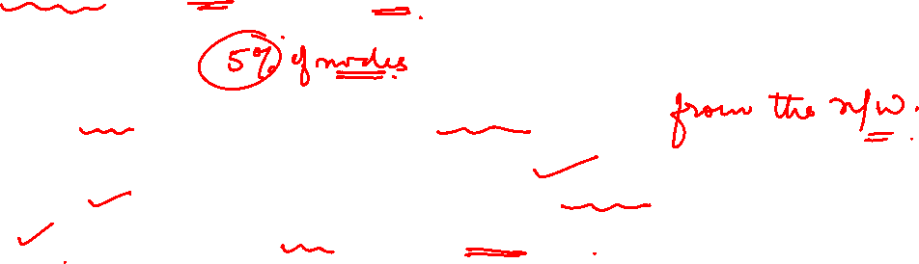
NETWORK ANALYSIS AND MINING
Disruption in scale free vs. random graph
Disruption
A random percentage of the nodes are removed
How does the diameter change?
Increases monotonically and linearly in random graphs
Remains almost the same in scale-free networks
Since a random sample is unlikely to pick the high-degree nodes

Slide 54
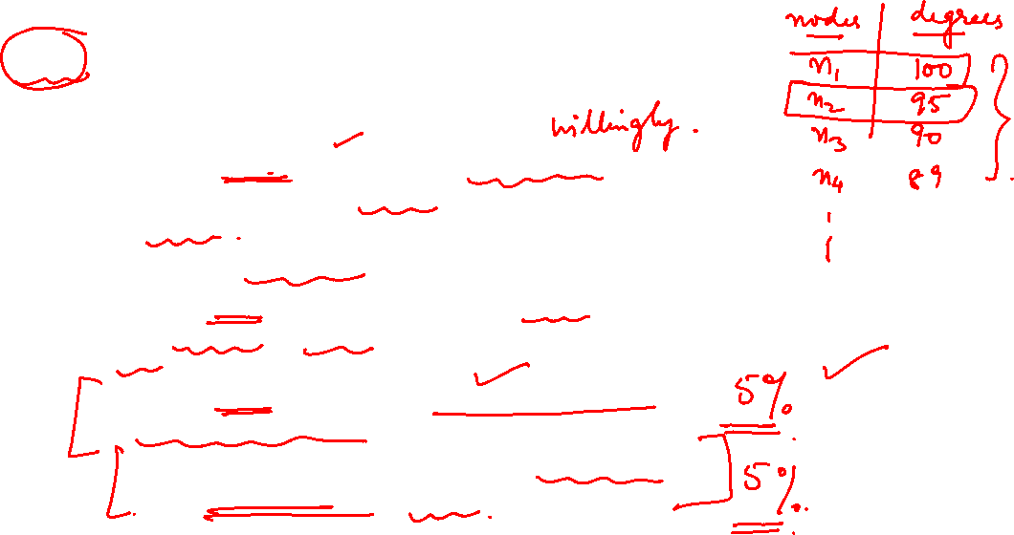
NETWORK ANALYSIS AND MINING
Attack in scale free vs. random graph
Attack
A percentage of nodes are removed willfully (e.g. from high degree in decreasing order of connectivity)
How does the diameter change?
For random networks, essentially no difference from disruption as all nodes are approximately same
For scale-free networks, diameter doubles for every 5% node removal!
This is an opportunity when you are fighting to contain spread of an epidemic

Slide 55
NETWORK ANALYSIS AND MINING
Modeling real world network with random graph
We have a real network where we know the number of nodes (n) and degree distribution.
We can compute the average degree c from the distribution
We can then compute p, by using “expected degree of a node” formula p= c/(n-1)
We can then generate the random graph. Using p and the number of nodes in the given network n, a random graph model G(n, p) can be simulated.

Slide 56
NETWORK ANALYSIS AND MINING
Summary
The assumption behind the random graph model is that connections in real-world networks are formed at random.
Although unrealistic assumption, random graphs can model average path lengths in real-world networks properly
It underestimate the clustering coefficient.
This degree distribution also falls off faster than an exponential in d, hence it is not a power-law distribution. This is because it is essentially a Poisson distribution
To tackle this issue (underestimates the clustering coefficient), we have the small-world model !

Slide 57
THANK YOU
Dr. Arti Arya
Department of Computer Science and Engineering

